Slide 1

19EID232: Internet of Things Unit-1: Introduction of Internet of Things (IoT)
Dr. M.S. Pradeep Kumar Patnaik
Assistant Professor
Department of EECE
GITAM Institute of Technology (GIT)
Visakhapatnam – 530045
Email: kmanipat@gitam.edu

Slide 2
Course Objectives
Introduce the fundamental concepts of IoT and physical computing
Expose the student to a variety of embedded boards and IoT Platforms
Create a basic understanding of the communication protocols in IoT communications.
Familiarize the student with application program interfaces for IoT.
Enable students to create simple IoT applications.

Slide 3
Learning Outcomes:
After completion of this unit, the student will be able to:
explain IoT architecture(L2)
interpret the design principles that govern connected devices(L2)
summarize the roles of various organizations for IoT(L2)

Slide 4
Introduction to Internet of Things (IoT)
Introduction Definition of Internet of Things IoT Growth Application Areas of IoT Characteristics of IoT Things in IoT IoT Stack Enabling Technologies IoT Challenges IoT Levels IoT vs. Cyberphysical Systems IoT vs WSN | Contents

Slide 5
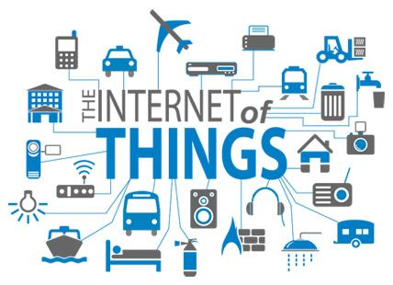
Why IOT?
We want to receive more data.
We want to control stuff.
We want to automate
We want to make things faster.

Slide 6
Origin of IoT
The term “Internet of Things” (IoT) was first used in 1999 by British technology pioneer Kevin Ashton.
System in which objects in the physical world could be connected to the Internet by sensors.
IoT was originally introduced by the "Auto-ID research centre" at the MIT .

Slide 7
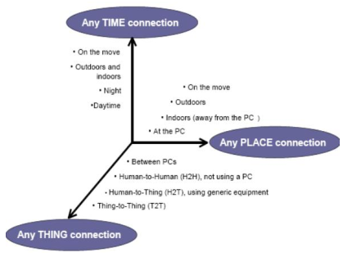
Origin of IoT

Slide 8
What is IoT
The Internet of Things (IoT) is the network of physical objects—devices, vehicles, buildings and other items embedded with electronics, software, sensors, and network connectivity—that enables these objects to collect and exchange data.
“IoT refers to the interconnection via the Internet of computing devices embedded in everyday objects, enabling them to send and receive data” .

Slide 9
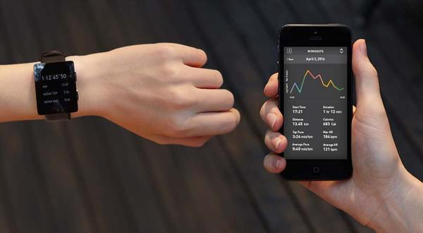
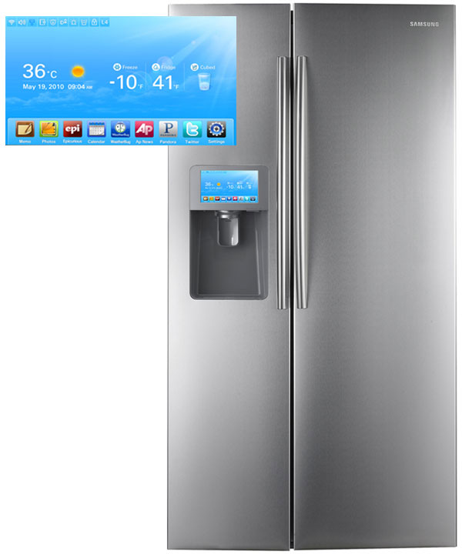
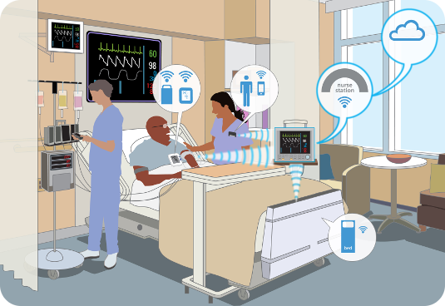
Information Security
Office of Budget and Finance
Education – Partnership – Solutions
Smart Appliances
Wearable Tech
Healthcare
Notes:
In our daily lives, we have become more reliant on IoT with our wearable tech, appliances, our cars, how we receive health care.

Slide 10
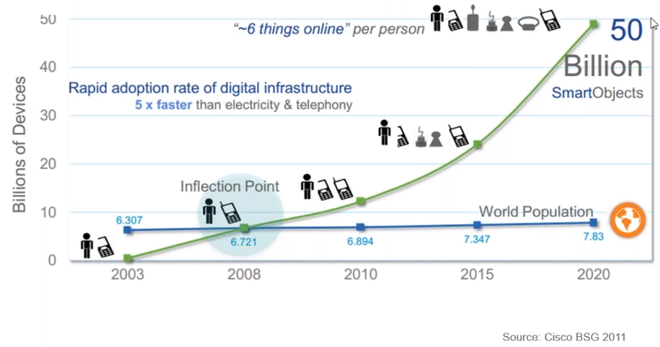
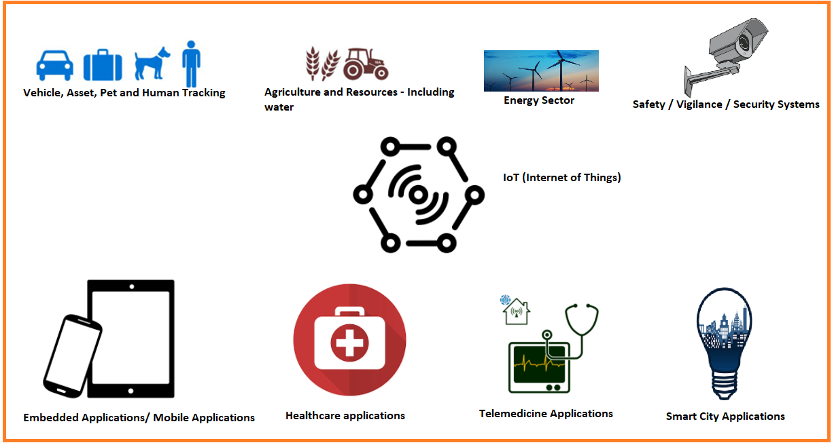
GROWTH and application sectors

Slide 11
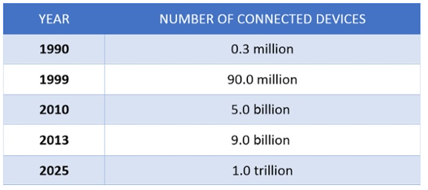
Application areas of IOT:
A report By Gartner stated that in coming future connected devices across all technologies will reach a number of 20.6 billion.

Slide 12
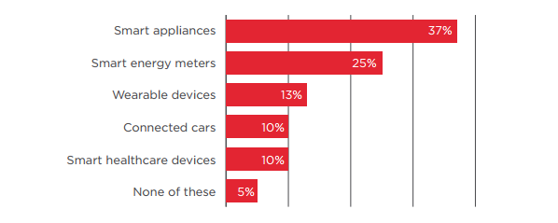
Hewlett Packard did a small survey and found that rise of connected devices over the years and the results they got are really amazing. These Connected Devices fills up the gap between physical and digital world so as to improve the quality and the productivity of life, society, industries, and business.

Slide 13
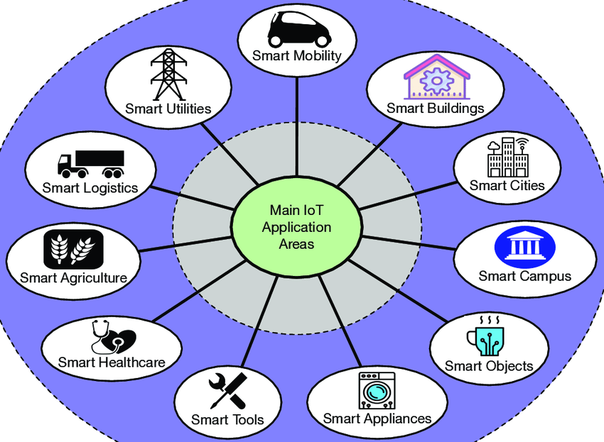
There are different Areas Where IoT is growing its roots.
Smart Homes.
Wearable’s.
Smart Cars.
Industries.
Smart Cities.
IoT in Agriculture.
Healthcare.
Power Engagement.

Slide 14
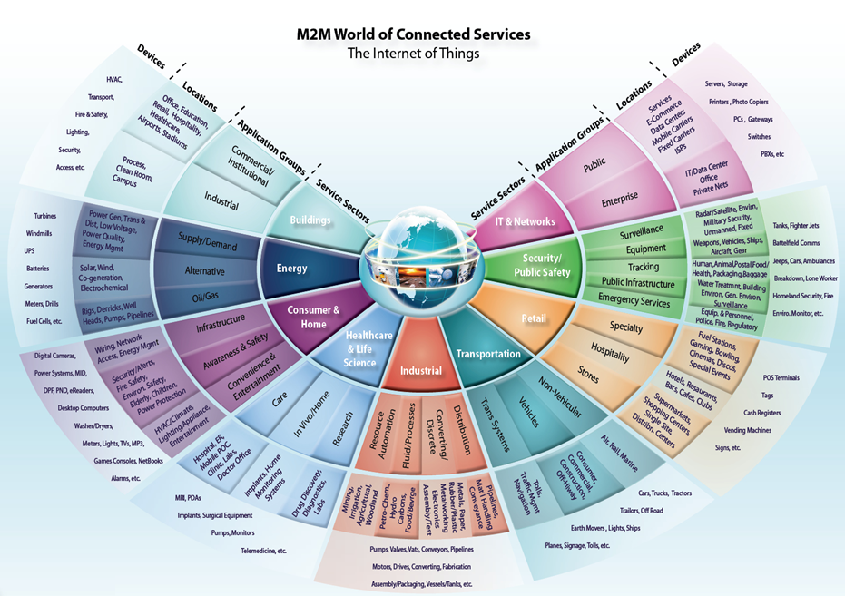
Information Security
Office of Budget and Finance
Education – Partnership – Solutions
Notes:
M2M/IoT Sector Map :: Beecham Research
http://www.beechamresearch.com/article.aspx?id=4
The following graphic from Beecham Research depicts how the Internet of Things may interact with various service sectors within the public/private sectors and ordinary consumers. Public sector entities (such as universities) may have some level of involvement and interaction within all service sectors depicted; ranging from the operation and industry elements of buildings, to levels of research, retail entities, transportation, and IT/Networks. **Place emphasis on service sectors, that it is likely that at least one example of devices may be found within university networks.

Slide 15
Characteristics of iot
Connectivity -- Things in iot should be connected to the infrastructure and connectivity is an important character/requirement for an iot infra. Anyone, anywhere, anytime – connectivity should be guaranteed in the iot infra. Without connection, nothing makes sense! (I say that, things are connected and they need connectivity)
Intelligence and identity -- The extraction of knowledge (i.e. what is to be inferenced) from the generated data is very important. Sensors generate data, the data is to be interpreted properly! Each iot device has an unique identity (remember ip address). This identity is helpful in tracking the equipment and at times to query the status.
Scalability – the number of things (devices) getting connected to iot infra is getting increased day by day. Hence, an iot setup shall be capable to handle the massive expansion. Also, the data generated shall be massive and it should be handled appropriately.
Dynamic and self adapting (complexity) – the iot devices should dynamically adapt itself to the changing contexts. Assume a camera meant for surveillance. It may have to work in different conditions as different light situations (morning, afternoon, night)
Architecture – architecture cannot be homogeneous in nature. It should be hybrid, supporting different manufacturer's product to be in the iot network.
SAFETY - Having got all the things connected to internet, the personal data (if sensitive) is under threat. Hence, securing the data is a major challenge . Not only data security, the equipment getting involved in IoT network is huge. Hence, persona safety is also to be considered. PRIVACY with PROTECTION! ☺

Slide 16
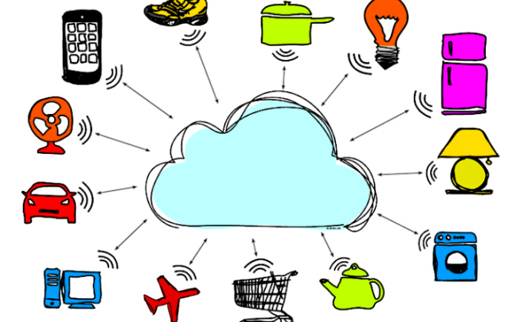
Things in internet of things
Things refer to variety of devices. Not really just one device become things.
At times, you and I are things! (Think, How)
Anything to qualify as a “THING” require identity.
(I told you this)
The “thing” can monitor/measure etc. means, a temperature sensor could be a thing!
Things are capable of exchanging data (could be sharing) with other connected devices in the infra.
The data could be stored in a centralized server (cloud computing), processed there and a control action could be initiated. The devices involved In getting this accomplished are things!!!!

Slide 17
Some of the famous things which you are aware of:
Temperature sensors
Pressure sensors
Humidity sensors etc.
The data from above sensors are collected (real time) and sent to the cloud. (sometimes, it could be a local server)
Based on the data analysis, the control action would be taken.
Example: switching off the water heater remotely, when the water is heated as per requirement.
Not just sensors, the following also can be called as things (see RHS).
Industrial motors
Wearables (your watch, band)
Vehicles
Shoes

Slide 18
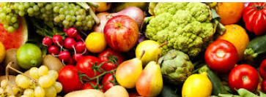
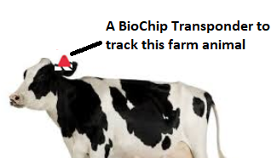
More things on the way!
Heart monitoring implants – PACE MAKER, I TELL YOU THIS IN MY SESSION!
Biochip transponders (For ANIMALS IN FARMS)
Automobiles with built-in sensors
Food / perishables quality measuring.
So, “things” == HARDWARE + SOFTWARE + SERVICE!.

Slide 19
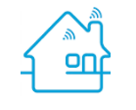
Things in an example (home automation)
control and automation of lighting,
heating (like smart thermostat),
Ventilation,
air conditioning (HVAC - Heating, ventilation and air conditioning (HVAC)) systems,
appliances such as washer/dryers,
air purifiers,
ovens or refrigerators/freezers that use Wi-Fi for remote monitoring.
Home work: What could be the things in smart retail environment? Guess!

Slide 20
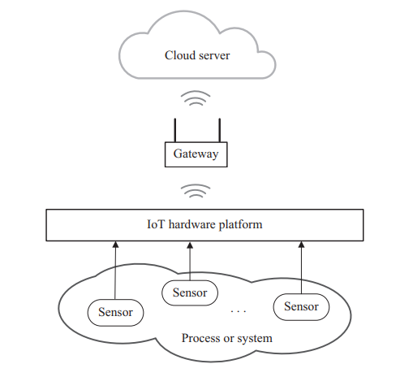
IOT stack

Slide 21
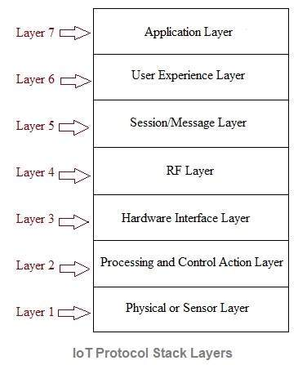
IOT Protocol stack

Slide 22
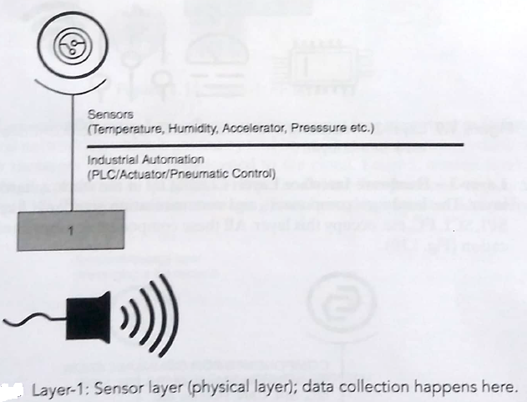
Physical or sensor layer:
The physical components are mainly sensors such as humidity sensor, temperature sensor, pressure sensor, heartrate sensor, pH sensor, odour sensor etc. The sensors are used for sensing of various parameters as per application of use. There are plenty of sensors available for same functionality and hence appropriate selection of sensor is done based on cost and quality. It is this layer-1 which provides sensed data to IoT stack for further processing. Hence selection of sensor is pivotal.

Slide 23
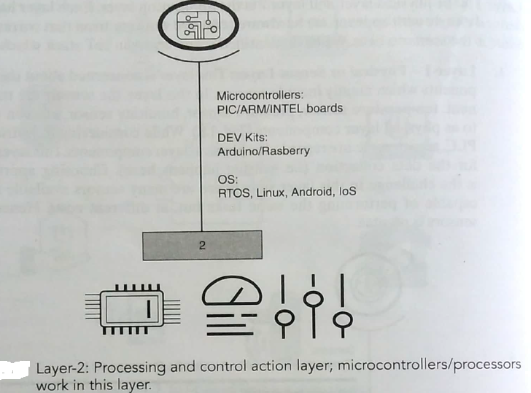
IoT Stack Layer 2-Processing and Control layer
Microcontroller/Processor and operating system play vital role at this layer. Various development kits can be used for this purpose such as Arduino, NodeMCU (based on ESP32 or ESP8266) , ARM(Advanced Risk machines),PIC(peripheral interface controller) etc. Typical operating systems used are Android, Linux, IOS etc.The data collected from the sensors are Processed here in this layer and determine if the data is meaningful,microcontroller should be present.

Slide 24
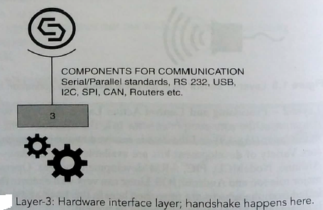
IoT Stack Layer 3-Hardware Interface layer
This layer include components or interfaces used for communication such as RS232, RS485, SPI(serial peripheral interface), I2C(inter intergrated circuit), CAN(controller area network), SCI(Serial communication interface) etc. These interfaces are used for serial or parallel communication at various baud rates in synchronous/asynchronous modes. The above-mentioned interface protocols ensure flawless communication.

Slide 25
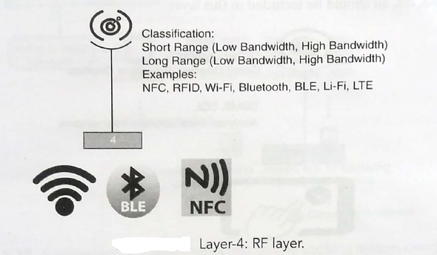
IoT Stack Layer 4-RF layer:
This radio frequency layer houses RF technologies based on short range or long range and data rate desired by the application of use. The common indoor RF/wireless technologies include Wifi, Bluetooth, Zigbee, Zwave, NFC(near field communication), RFID etc. The common outdoor RF cellular technologies includeGSM(globalsystemformobiles)/GPRS(general packet radio service), CDMA, LTE-M, NB-IoT, 5G etc. RF layer does communication of data using radio frequency-based EM waves. There is another technology which uses light waves for data communication. This light based data communication is referred as LiFi.

Slide 26
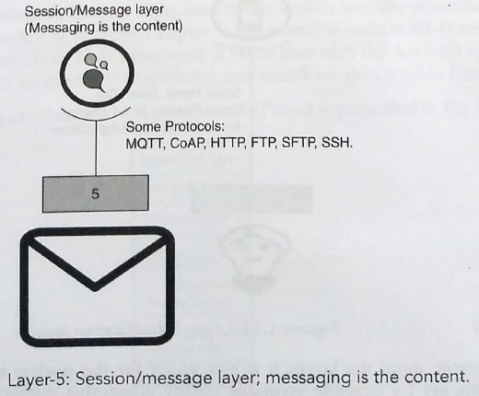
IoT Stack Layer 5-Session/Message Layer :
There are protocols which over –see how messages(data) are broadcasted to the cloud.This layer deals with various messaging protocols such as MQTT, CoAP, HTTP, FTP (or Secured FTP), SSH etc. It defines how messages are broadcasted to the cloud.

Slide 27
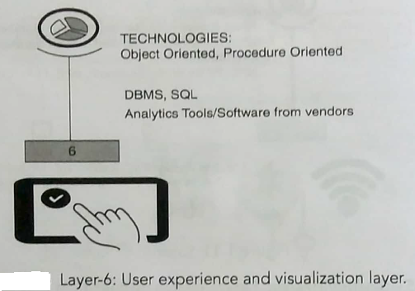
IoT Stack Layer 6-User experience layer :
This layer deals with providing best experience to the end users of IoT products. To fulfill this, this layer takes care of rich UI designs with lots of features. Various languages and tools are developed for the design of GUI interface softwares. These include objected oriented and procedure-oriented technologies as well database languages (DBMS, SQL) in addition to analytics tools.

Slide 28
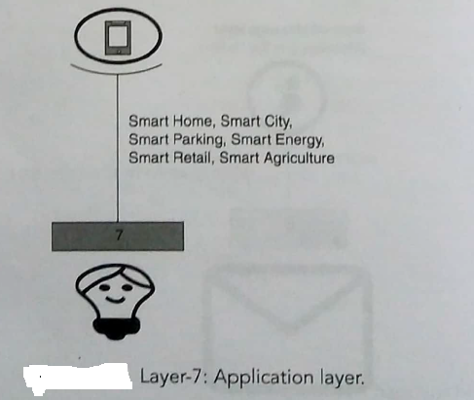
IoT Stack Layer 7-Application layer :
Application layer talks about the possible applications which can be built with the support of the rest of the layers. It can range from a simple automation application to smart city application.

Slide 29
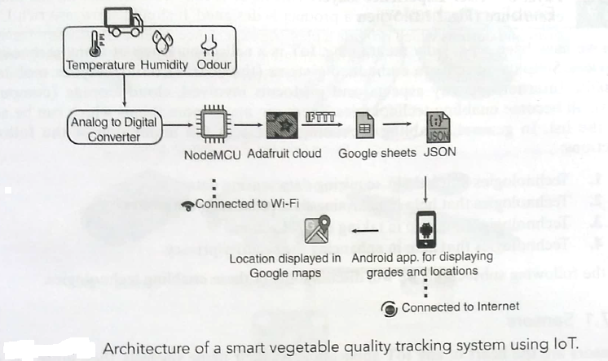

Slide 30
The above diagram is related to Vegetable quality monitoring transport from source to the destination using IOT.
The scenario is to set the tempo, the architecture diagram of the smart vegetable quality tracking application for transport is presented.
It starts with sensor layer, where temperature, humidity etc. are measured. Then data goes to the microcontroller; from there it goes to the cloud(Adafruit) and here the messaging protocols come in picture.
Adafruit is the cloud storage platform being used in the application.
RF protocols such as Wi-Fi are used for transport and communication.
JSON (JavaScript Object Notation) is a lightweight data-interchange format. It is easy for humans to read and write.
Use experience is taken care with Android application designed.

Slide 31

IoT(internet of things) Enabling Technologies
IOT is a collection/group of many technologies/devices.
Starting from the simplest of sensors, embedded systems (the boards), data analytics, mobile and mobile internet, security aspects, protocols involved, cloud storage (computing) – all these become enabling technologies.
Overall, enabling technologies/devices shall fall under any of the following sections:
Technologies help in acquiring data / sensing data
Technologies that help in analyzing data / processing data
Technologies that help in taking control action
Technologies that help in enhancing the security / privacy

Slide 32
IoT(internet of things) enabling technologies are
Wireless Sensor Network
Cloud Computing
Big Data Analytics
Communications Protocols
Embedded System

Slide 33
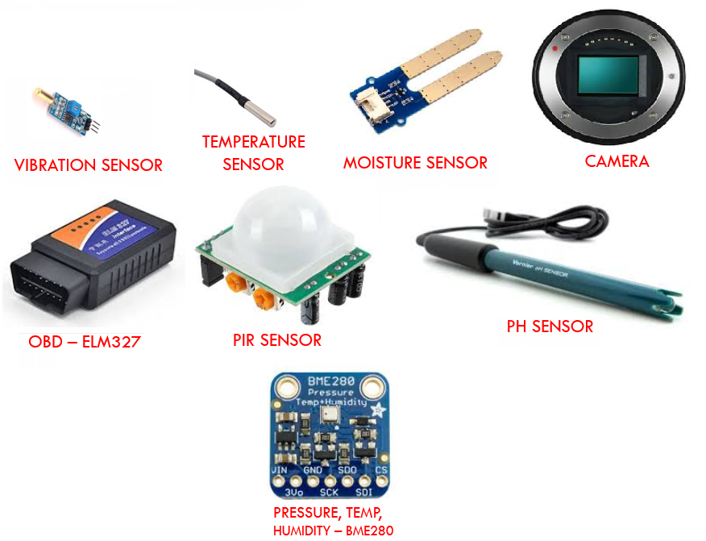
Sensors:
Sensors are the heart of any IOT application. They sense the environment and retrieve the data.
An example of a sensor is a simple temperature monitoring application like a thermometer(temperature sensor):it fetches data for us to operate on. Sensors could be analog or digital.
Some examples of sensors which could be regarded as enabling technologies:
i. The camera used in home security system is a sensor.
ii.Weather tracking system could use the temperature/humidity/moisture sensors and their data could be analyzed.
iii.Vehice heath monitoring sensors keep track of speed ,tyre pressure etc.
iv.Vibration sensors are used to track the quality of building/structures.
v.Water quality is monitored through sensors that measures PH,turbidity,chloride level,etc.
vi. Pedestrian signal operation with human presence detection with PIR sensor .
[https://www.utmel.com/blog/categories/sensors/ten-smart-sensor-technology-trends-for-iot-applications]

Slide 34
Cloud Computing :
It provides us the means by which we can access applications as utilities over the internet. Cloud means something which is present in remote locations. With Cloud computing, users can access any resources from anywhere like databases, webservers, storage, any device, and any software over the internet. Characteristics –
Broad network access
On demand self-services
Rapid scalability
Measured service
Pay-per-use
Provides different services, such as –
.Iaas (infrastructure as a service)
.Paas (platform as a service)
.Saas (software as a service)
Some examples:
Amazon web services
Azure
Adafruit and many more

Slide 35
Provides different services, such as –
IaaS (Infrastructure as a service) Infrastructure as a service provides online services such as physical machines, virtual machines, servers, networking, storage and data center space on a pay per use basis. Major IaaS providers are Google Compute Engine, Amazon Web Services and Microsoft Azure etc. Ex : Web Hosting, Virtual Machine etc.
PaaS (Platform as a service) Provides a cloud-based environment with a very thing required to support the complete life cycle of building and delivering West web based (cloud) applications – without the cost and complexity of buying and managing underlying hardware, software provisioning and hosting. Computing platforms such as hardware, operating systems and libraries etc. Basically, it provides a platform to develop applications. Ex : App Cloud, Google app engine
SaaS (Software as a service) It is a way of delivering applications over the internet as a service. Instead of installing and maintaining software, you simply access it via the internet, freeing yourself from complex software and hardware management. SaaS Applications are sometimes called web-based software on demand software or hosted software. SaaS applications run on a SaaS provider’s service and they manage security availability and performance. Ex : Google Docs, Gmail, office etc.
[https://www.youtube.com/watch?v=36zducUX16w]

Slide 36
Big Data Analytics :
It refers to the method of studying massive volumes of data or big data. Collection of data whose volume, velocity or variety is simply too massive and tough to store, control, process and examine the data using traditional databases.
Big data is gathered from a variety of sources including social network videos, digital images, sensors and sales transaction records.
Several steps involved in analyzing big data –
1.Data cleaning
2.Munging [manipulation]
3.Processing
4.Visualization
Examples –
a.Bank transactions
b.Data generated by IoT systems for location and tracking of vehicles
c.E-commerce and in Big-Basket
d.Health and fitness data generated by IoT system such as a fitness bands

Slide 37
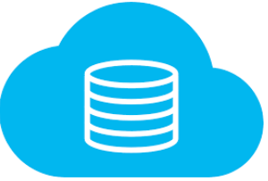
Big data – very big data!! (data analytics)
Some make it 3Vs. Some make it 4Vs.
1-Scale (Volume) – huge volume of data generated every minute! Storage has become cheaper; hence we survive! Challenges have reduced. Cloud storage and hardware both become affordable.
2-Complexity (Variety) – data is in different formats. Say audio, video, text, image and many more. This provides a huge challenge.
3-Speed (Velocity) –velocity is the rate at which data is generated is very fast. Also, change in the data dynamics is very high. Nowadays, data can come from anywhere-from watches to refrigerators.
4- data in doubt (veracity) – the data’s nature is getting changed quickly and ambiguity is seen (incomplete data) .Hence it would be pretty challenging to process this unstable data.
So, who here generate data?
Sensors from the security system
Sensors from weather monitoring system
Sensors from the car / navigation system
Sensors from water quality monitoring system
Data from wearables (band)
Data from industrial equipment (say, motor health)
Sensors from bridges/roads about the traffic density etc.
Social media (your tweet and my photo upload)
so, data everywhere!

Slide 38
Communications Protocols :
They are the backbone of IoT systems and enable network connectivity and linking to applications. Communication protocols allow devices to exchange data over the network. Multiple protocols often describe different aspects of a single communication. A group of protocols designed to work together is known as a protocol suite; when implemented in software they are a protocol stack. They are used in
Data encoding
Addressing schemes

Slide 39
Protocols for the communication is very vital and in fact is the pillar for good iot infra.
Data exchange happens through this protocols.
Protocols takes care the following:
Addressing
Format of the messages
Message security (encryption & decryption)
Routing.
Flow control.
Error monitoring.
Sequencing.
Retransmission guidelines.
Segmentation of the data packets.
Protocols for link layer (Ethernet), network layer (ip), transport layer (tcp/udp), application layer (mqtt, http, xampp).

Slide 40
Embedded Systems :
It is a combination of hardware and software used to perform special tasks. It includes microcontroller and microprocessor memory, networking units (Ethernet Wi-Fi adapters), input output units (display keyword etc. ) and storage devices (flash memory). It collects the data and sends it to the internet. Embedded systems used in Examples –
Digital camera
DVD player, music player
Industrial robots
Wireless Routers etc.

Slide 41
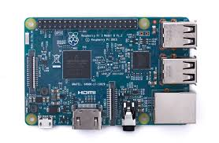
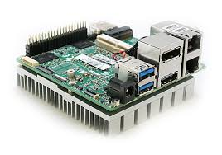
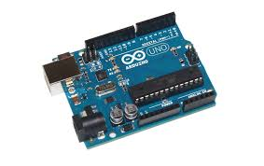
Embedded Systems
This is very important and foremost!
Mostly meant for prototyping. (even, productizing)
Driven by Microcontrollers / processors
Computing boards in market are really plenty!
Raspberry pi
Arduino (many variants)
Node mcu
Intel Edison
Intel UP Squared* Grove* IoT Development Kit
All these boards are so small, yet so smart!
Also, not very expensive!

Slide 42
Challenges in Internet of things (IoT)
The Internet of Things (IoT) has fast grown to be a large part of how human beings live, communicate and do business. All across the world, web-enabled devices are turning our global rights into a greater switched-on area to live in.There are various types of challenges in front of IoT.
security / PERSONNEL SAFETY .
Privacy.
Data extraction from complex environments.
Connectivity.
POWER REQUIREMENTS.
Complexity .
storage (cloud)

Slide 43


Challenge – 1 -security / PERSONNEL SAFETY
Very high rated / most important challenge.
More number of devices are used in the iot infra and this is a challenge.
User data could be vulnerable for theft.
People’s personal safety is a concern and challenge too (implants, sensors)
Since, many devices are in the loop, one device if getting attacked, rest of the devices could also be attacked.
Poor security features can let the attackers damage the whole network.
DATA SECURITY
PERSONNEL SAFETY

Slide 44

Challenge – 2-privacy
you could be tracked / monitored by anyone, as you are connected 24x7 in the internet.
you could be tracked without your permission in place.
So, there is a threat! – How do we ensure that the data which is sensed/collected from the user is with their permission?
I NEED PRIVACY

Slide 45
Challenge – 3-data extraction from complex environments
It is huge challenge to sense/extract data from complex environments.
For an instance, how to sense the data (temperature/humidity etc) during transport from a vehicle?
Assume, a very temperature sensitive material is being transported,were the measurement is always expected to be perfect.
Variation in temperature could damage the products being transported as well.
Also in IOT based applications, internet is needed and is a mandatory at most of the places .
Providing internet may not be easy all the times in hilly areas.
Hence data extraction and sending the data to the cloud could be more challenging.

Slide 46
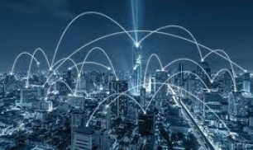
Challenge – 4-connectivity
Since the internet is itself a giant collection of networks and devices and IOT is a part of it,so requirement of wired and wireless connectivity!
Usage frequency / spectrum is also to be remembered (2.4 GHz band is obvious band everywhere) .
There are spectrum regulations to be followed ,based on the country for which the application is being developed.

Slide 47


Challenge – 5 POWER REQUIREMENTS
All the iot devices need power. Most of them are battery operated.
Thanks to long lasting batteries!
However, demand for power is ever on the rise and usage of green power sources like solar/wind is to be motivated.

Slide 48
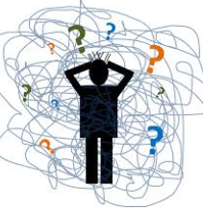
Challenge – 6 -complexity involved
Iot is not easier!
Why so?
Needs lot of different domains to come together.
Limited expertise in the market. (rapid growth)
The toolkits, software, hardware not abundant and it needs real skill to build an application.

Slide 49
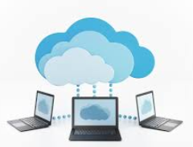
Challenge – 7- storage (cloud)
Cloud is becoming mandatory for the data to be stored and analysed.
The challenge with respect to this aspect would be connected to the following points:
Which cloud to use(private,public or hybrid)?
How to identify the service provider?
How much does it cost?
Do we really need cloud?

Slide 50
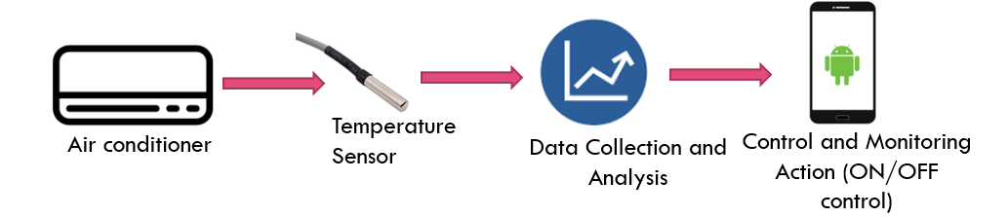
IoT levels LEVEL-1-Sensor
Based on the architectural approach, IoT can be classified in five levels.
L-1:Have one sensor / device to sense. (could be temp sensor/pressure sensor etc.)
The data to be stored in locally.
Data analysis to be done.
Monitoring / control can be done through an application (.apk or webapp)
This is used for simple applications with limited complexity or no complexity
Data is not huge. Means, not a big data here!
All the control happens through internet.
Example: Room temperature is monitored using temperature sensor and data is stored/analyzed locally. Based on analysis made, control action is triggered using mobile app or it can just help in status monitoring.

Slide 51
Level-2-Cloud storage
This level consists of air conditioner, temperature sensor, Big data (Bigger than level -1, data analysis done here) , cloud and control & monitoring app.
• This level-2 is complex compared to level-1. Moreover rate of sensing is faster compared to level-1.
• This level has voluminous size of data. Hence cloud storage is used.
• Data analysis is carried out locally. Cloud is used for only storage purpose.
• Based on data analysis, control action is triggered using web app or mobile app.
• Examples: Agriculture applications, room freshening solutions based on odour sensors etc.

Slide 52
IoT Level 3-Cloud Analysis
This level consists of air conditioner, temperature sensor, big data collection (Bigger than level-1) , cloud (for data analysis) and control & monitoring app.
• Data here is voluminous i.e. big data. Frequency of data sensing is fast and collected sensed data is stored on cloud as it is big.
• Data analysis is done on the cloud side and based on analysis control action is triggered using mobile app or web app.
• Examples: Agriculture applications, room freshening solutions based on odour sensors etc. Where the analysis of data should happen in the cloud.

Slide 53
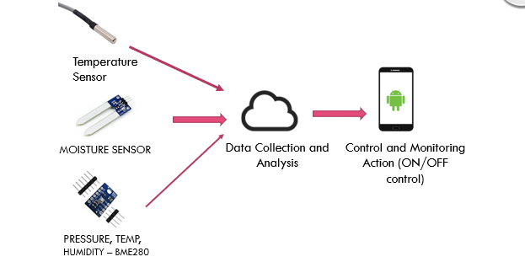
IoT Level 4-Cloud computing
This level consists of multiple sensors, data collection and analysis and control & monitoring app. • At this level-4, multiple sensor nodes are used which are independent of the others. • The data collected using these sensors are uploaded to the cloud separately. The cloud storage is used in this level due to requirement of huge data storage. • The data analysis is performed on the cloud and based on which control action is triggered either using web app or mobile app.

Slide 54
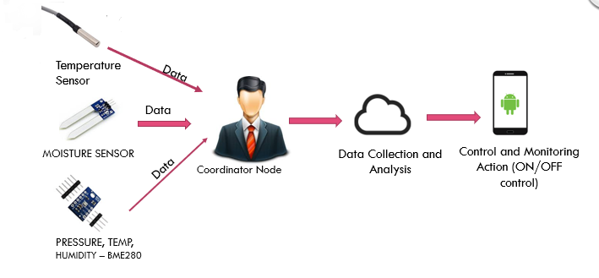
IoT Level 5- Cloud Orientation
This level consists of multiple sensors/nodes which are independent of each other, coordinator node, data collection and analysis and control & monitoring app. • This level is similar to level-4 which also has huge data and hence they are sensed using multiple sensors at much faster rate and simultaneously. • The data collection and data analysis is performed at the cloud level.
When an application is completely cloud oriented, it is computationally intensive and real-time. • Based on analysis, control action is performed using mobile app or web app.

Slide 55
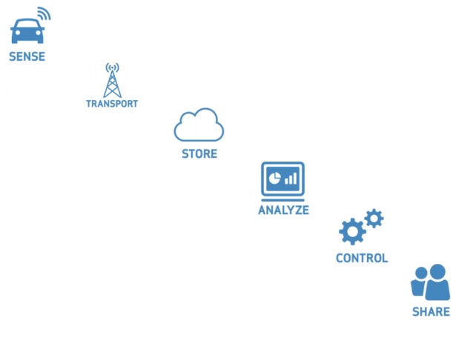
So, what have we understood? IoT in a nutshell

Slide 56
Is Cyber Physical System the same as IoT?
IoT---it is all about things getting uniquely identified through an address or identifier.
The thing also can be accessed from anywhere, anytime by an authorised party.
The information, the sensed data can be as simple as an RFID read.
Hence, the complexity involved in IoT application is minimal and not complex.
For complex levels of operation and to address larger network of “things”, a new term is introduced called Cyber Physical System, or CPS.

Slide 57
CPS is not IoT. It has IoT as one of its components.
CPS is more complex than IoT. and is very challenging as well.
It is a combination of multiple engineering domains coming together, which includes computer science, electronics, electrical and mechanical engineering.
It also has IoT as one of the components. Obviously the complexity increases by volumes. A flight (aeroplane) can be seen as a CPS which has the influence of multiple domains of engineering.
CPS is expected to be much more brilliant and autonomous, taking appropriate decisions as and when needed.
It is not merely about identifying, it is more about understanding and taking decisions in a much more dynamic way.
CPS is mainly concerned about the collaborative activity of sensors/actuators to achieve a certain goal and to do this CPS uses an IoT system to achieve the collaborative work of the distributed systems.

Slide 58
Is WSN the same as IoT?
WSN is a network .
The network is built with multiple autonomous sensors.
The sensors could be pressure, moisture, temperature, humidity,sound and so on.
All the sensed data are passed to the centrally located server.
The data passing happens in a coordinated pattern. WSN is basically composed of nodes(from few to few thousands).
Each node has one or more sensors.
Simply WSN is all about coordinated data collection.
Whereas IoT is much more than just data collection and the systems are more intelligent.

Slide 59
Links
https://www.youtube.com/watch?v=WcfqDyk7dkA
https://www.youtube.com/watch?v=aj4MJil6pow
https://www.youtube.com/watch?v=ZwjlONyV05Q
https://www.youtube.com/watch?v=6vTXsHbkSmg&t=697s

